Slide 1

HEART DISEASE ANALYSIS
Project Team : #11
Team Members: Padmavathi Vyshnavi Madarampalli | Surendar Mani

Slide 2
Introduction
Primary Objective: Predicting cholesterol levels using linear regression
Dataset Overview: 10,000 observations, 21 features/variables
Why Cholesterol?
  Because of its relationship with heart health outcome and one of the leading indicator for cardiovascular health
  A direct measurement to be considered for cardiovascular risk
  Also, serves as one of the primary factor doctors recommend to get in control for heart disease prevention
  It is responsive to both lifestyle factors and medications

Slide 3
Data Overview
Dataset acquired from Kaggle : https://www.kaggle.com/datasets/oktayrdeki/heart-disease/data
Important variables inside the dataset:
Demographic : Age, Gender
Vital Measurement: Blood Pressure, Cholesterol Levels, BMI
Lifestyle factors: Exercise Habits, Smoking, Alcohol Consumption, Sleep Hours
Medical history: Family Heart Disease, Diabetes
Biomarkers: Triglyceride Level, Fasting Blood Sugar, CRP Level, Homocysteine Level
Diagnostic Indicators: Heart Disease Status

Slide 4
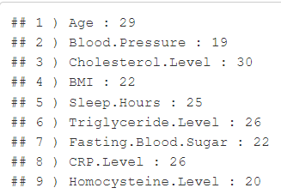

Data Cleaning (step 1)
Missing values (found using is.na()) in numerical variables:
  Number of records affected per column:
  Number of columns affected:

Slide 5
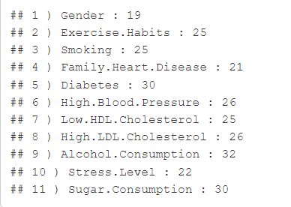
Data Cleaning (step 2)
Blank String values (found using dataset==“”) in categorical variables:
  Number of records affected per column:
  Number of columns affected:

Slide 6

Data Cleaning (step 3)
Total number of non-blank columns in the dataset:
Columns with no missing values:

Slide 7
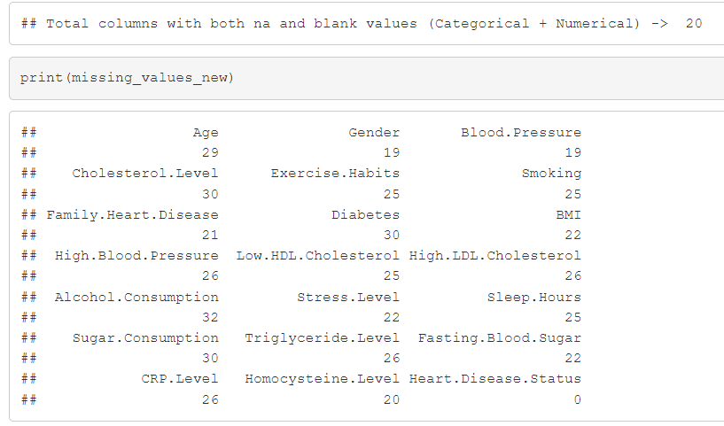
Data Cleaning (Summary)
Cleaning steps :
Use is.na() to remove na values in numerical columns. Identified blank string and converted them to na values in categorical columns and used is.na() to remove them all.

Slide 8
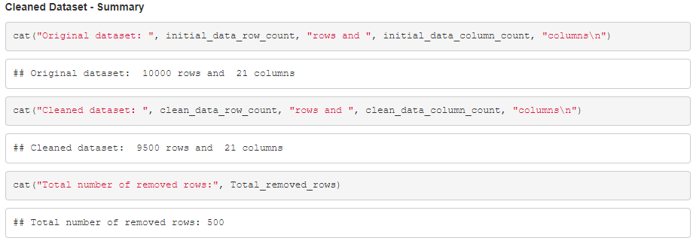
Dataset Summary (After Cleaning)

Slide 9
Exploratory Data Analysis (EDA)
What is EDA?
It is the process of summarizing the main characteristics of the dataset, visualizing patterns, spotting outliers and anomalies, forming early hypotheses for modeling.
Why EDA?
  EDA helps us understand the data before building models, so we don't blindly trust the numbers.
    Distribution Understanding → Histogram, Overlayed Histogram
    Outlier Detection → Boxplot
    Variable Relationships → Correlation Analysis
    Basic Statistics → Statistical Summary (Mean, Median, SD)

Slide 10
Exploratory Data Analysis (EDA)
Summary of EDAs done in this project:
  Distribution of categorical variables – barplot
  Distribution of numerical variables – boxplot
  Distribution of response variable(Cholesterol) – histogram
  Distribution of Cholesterol Categories – barplot
  Relationship between Cholesterol and categorical variables - boxplot
  Relationship between Cholesterol and numerical variables - barplot

Slide 11
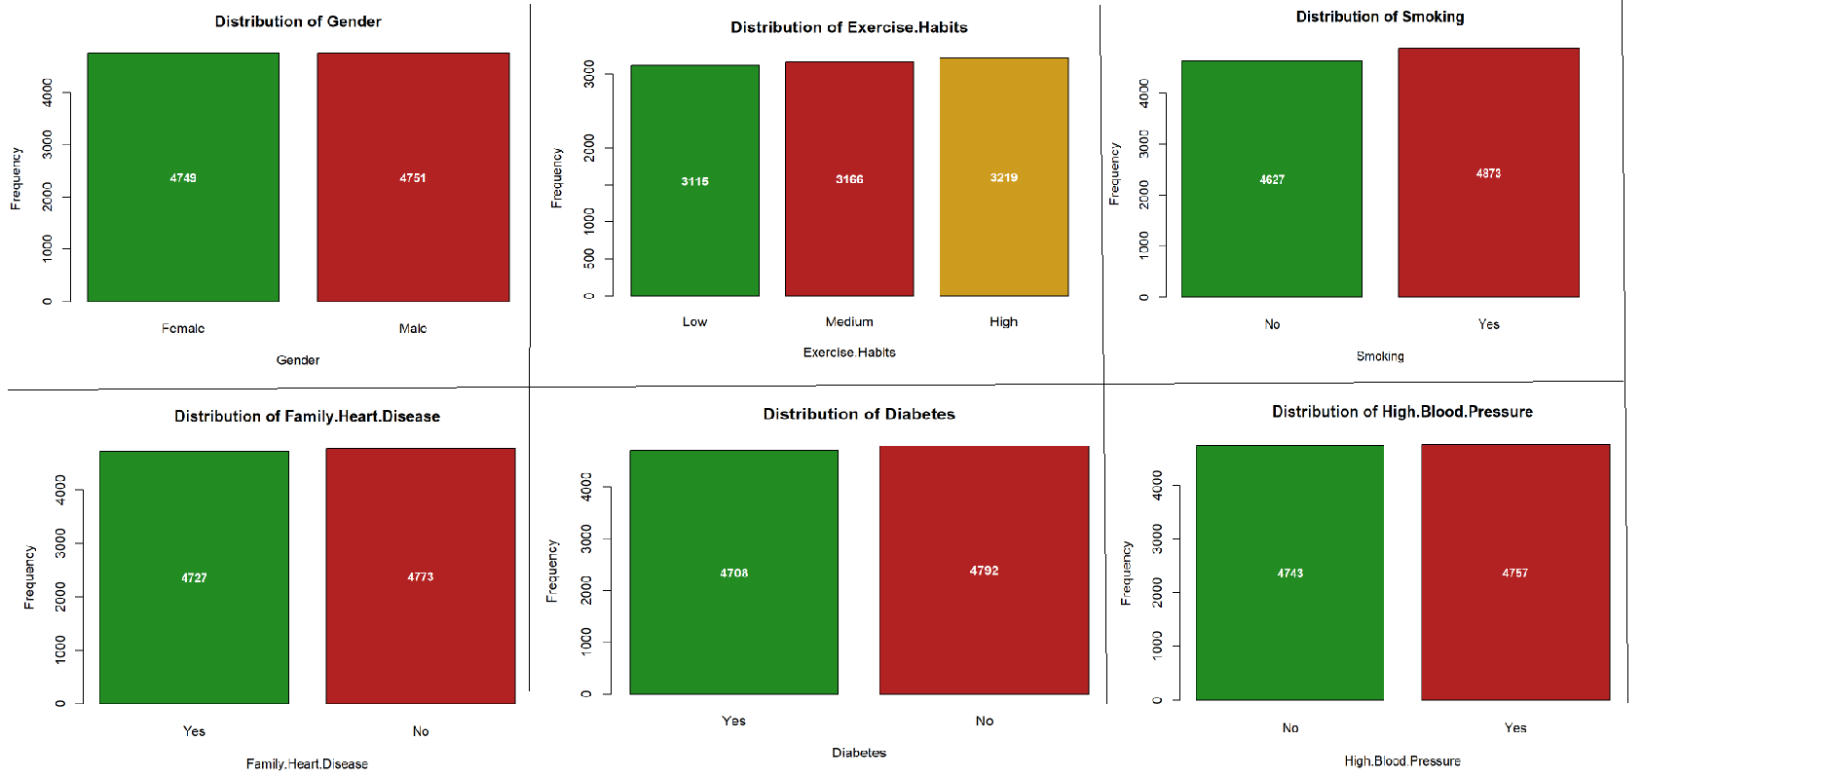
Distribution of categorical variables (using barplot)

Slide 12
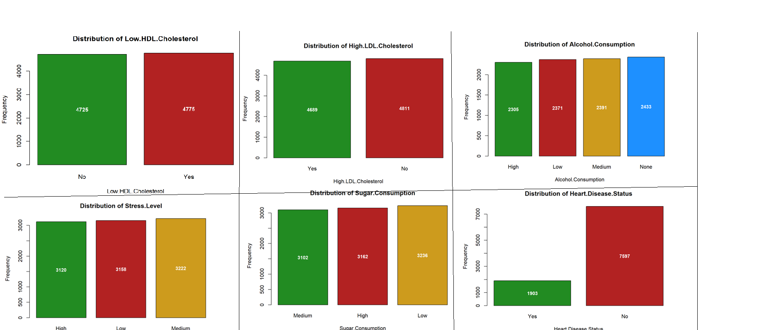
Distribution of categorical variables (using barplot)

Slide 13
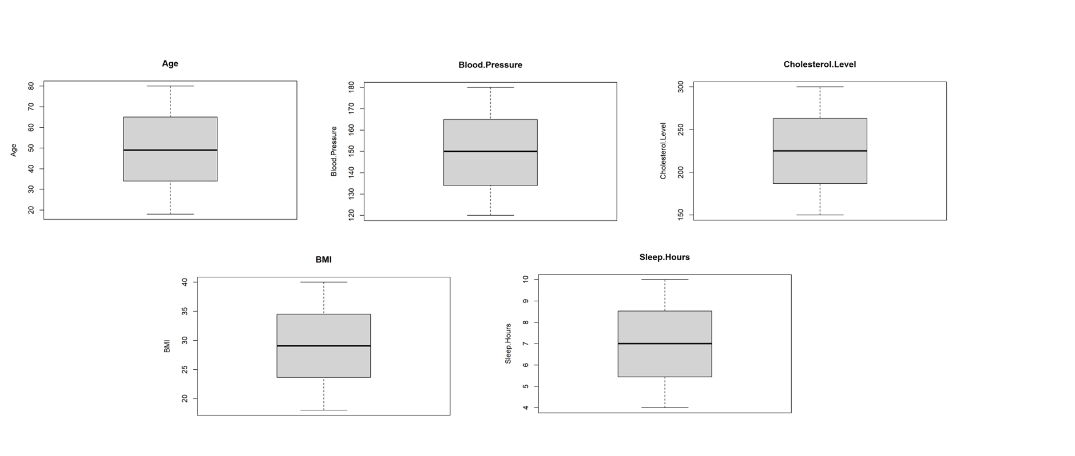
Distribution of numerical variables – using boxplot

Slide 14
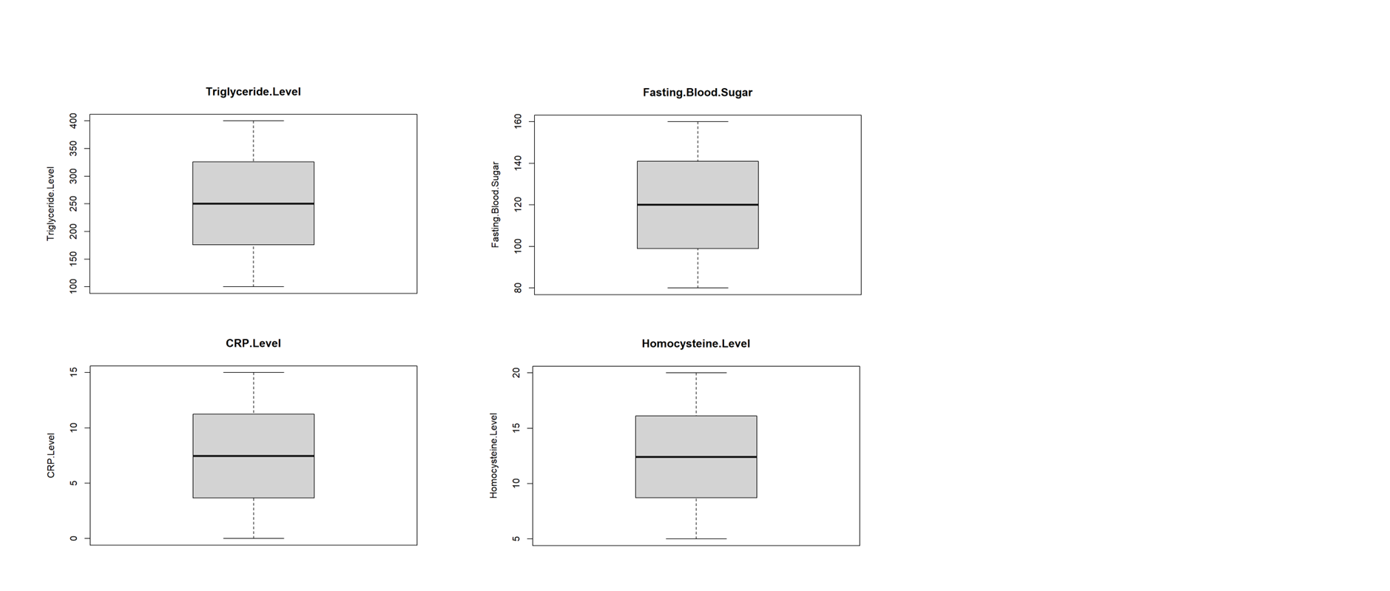
Distribution of numerical variables – using boxplot

Slide 15
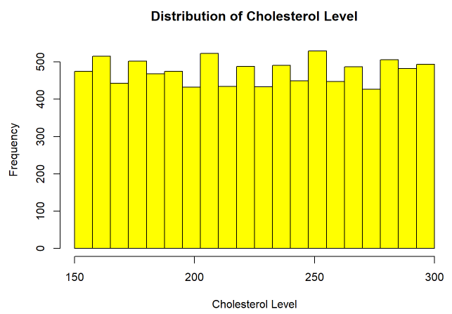
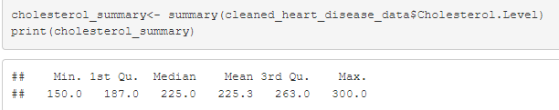
Summary of Cholesterol Level

Slide 16
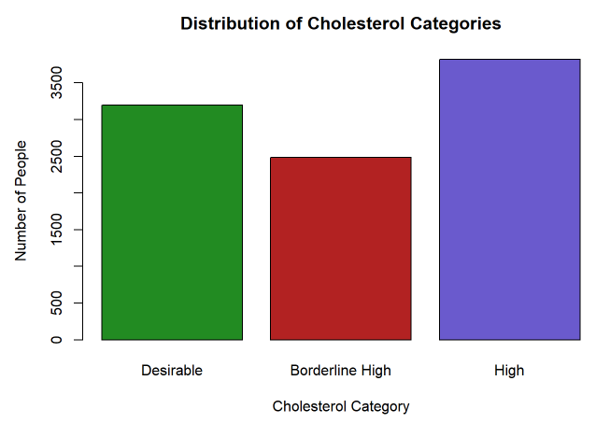

Distribution of Cholesterol Categories

Slide 17
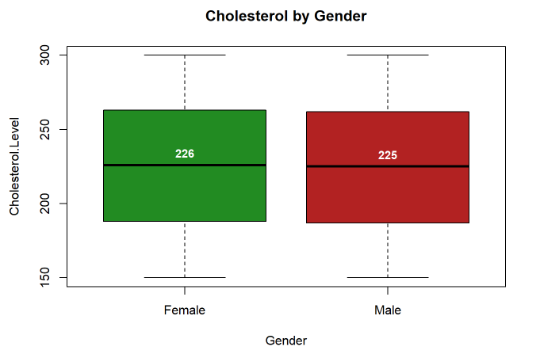
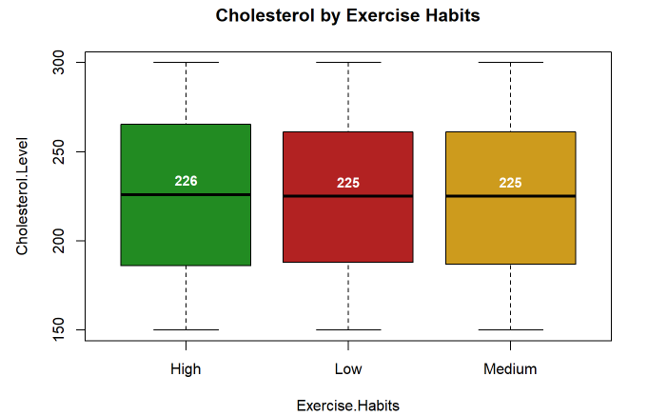
Relationship - Cholesterol Level ~ categorical variables

Slide 18
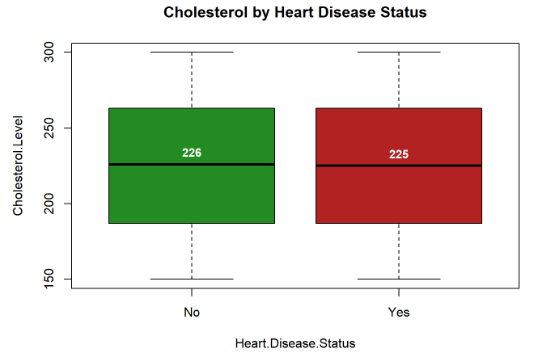
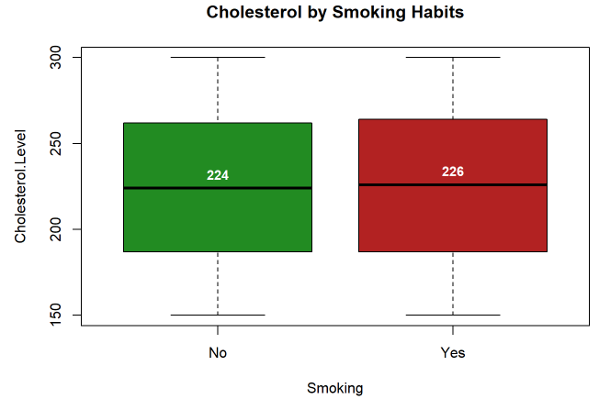
Relationship - Cholesterol Level ~ categorical variables

Slide 19
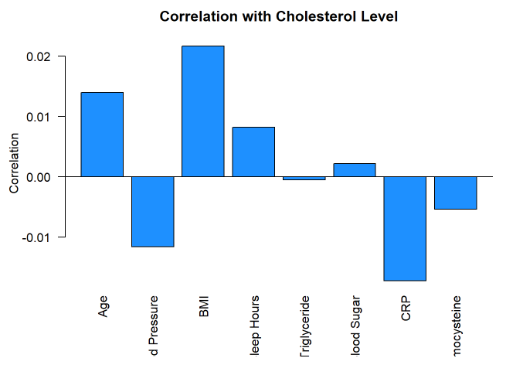
Relationship - Cholesterol Level ~ numerical variables

Slide 20
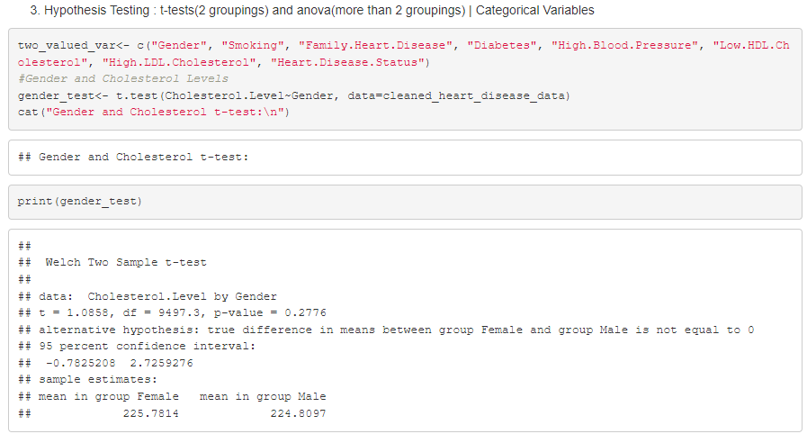
Hypothesis Testing (Approach)
Categorical Variable with exactly 2 categories (t-test)

Slide 21
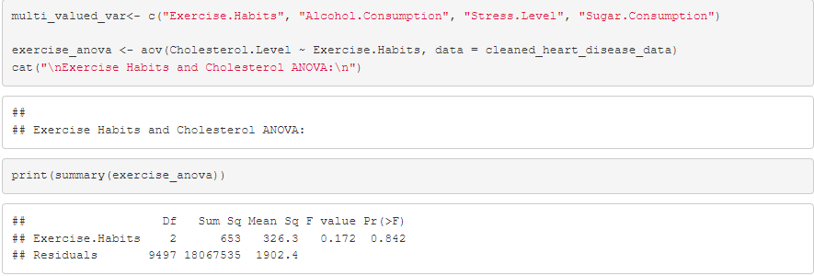
Hypothesis Testing (Approach)
Categorical Variable with more than 2 categories (ANOVA)

Slide 22
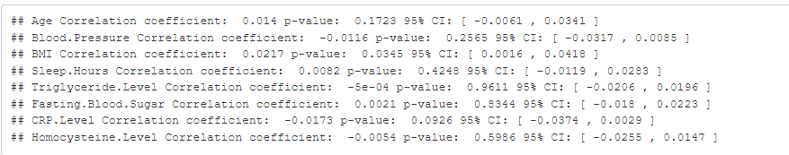
Hypothesis Testing (Approach)
Numerical Variable (Correlation test)

Slide 23
Hypothesis Testing (Summary)
Significant categorical variables (p < 0.05): None of the t-test, and anova categorical columns have p<0,05 showing that neither have a statistically significant effect on cholesterol levels within the dataset)
Significant numerical variables (p < 0.05): BMI has a p value(statistical significance) of 0.0345 which is less than 0.05 but the correlation is extremely weak with r value(practical significance) as 0.0217, showing weak relationship. r value is positive meaning BMI increases, then cholesterol tend to increase slightly but the value is close to zero telling us that the relationship is very weak.
Overall finding: ‘Almost all the variables did not show significant relationships with cholesterol levels’
What next?
With weak relationships, we wanted to try and see whether combination of variables would provide anything valuable and do a better prediction with cholesterol level.

Slide 24
Linear Regression Modeling (Approach)
Train-Test Split - > 70%|30%
Model with combination of variables
Full model
Subset selection (Full | Forward step | Backward step)

Slide 25
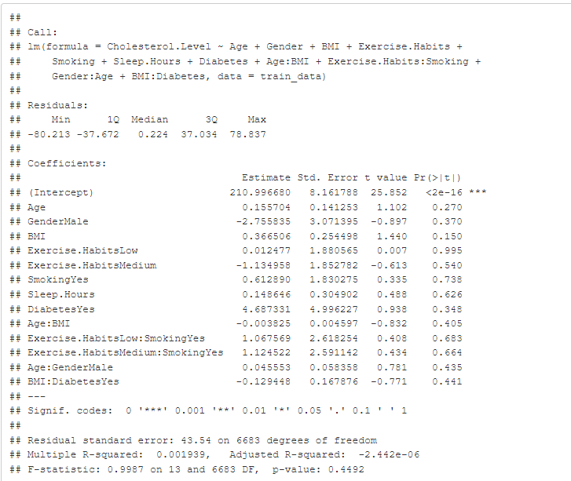
Linear Regression Modeling (Approach)
Model with combination of variables

Slide 26
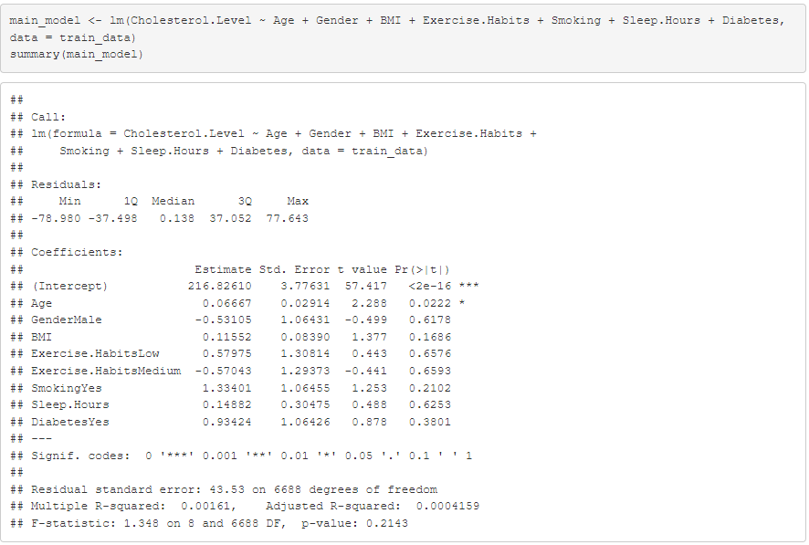
Linear Regression Modeling (Approach)
Full model (Individual Variables)

Slide 27
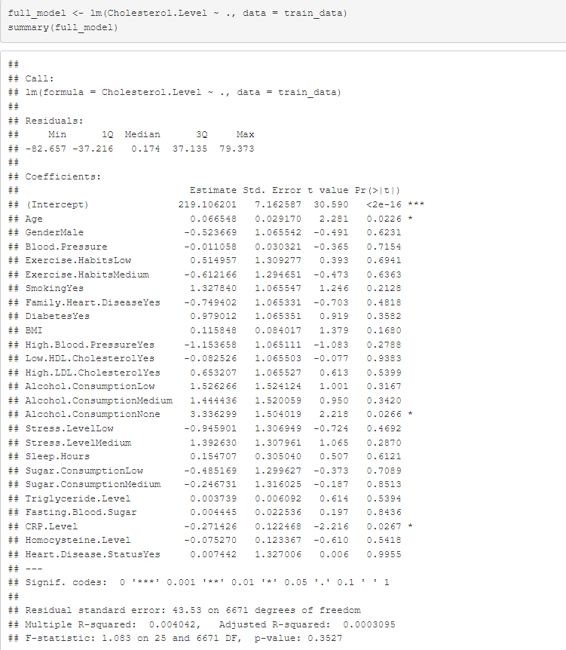
Linear Regression Modeling (Approach)
Subset selection (Full):

Slide 28
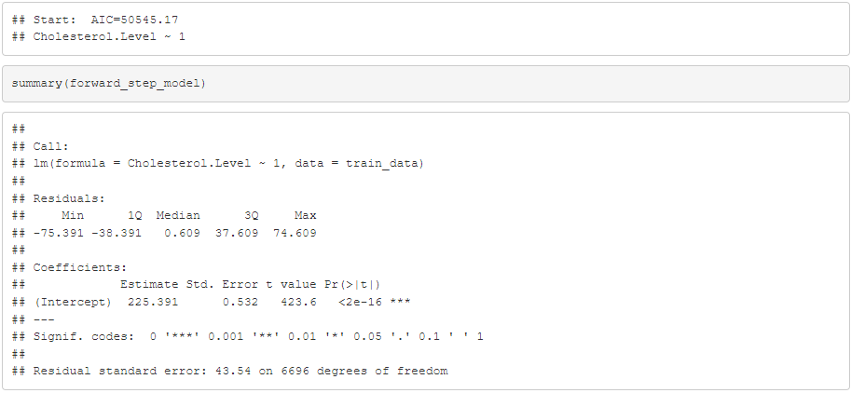
Linear Regression Modeling (Approach)
Subset selection (Forward Step):

Slide 29
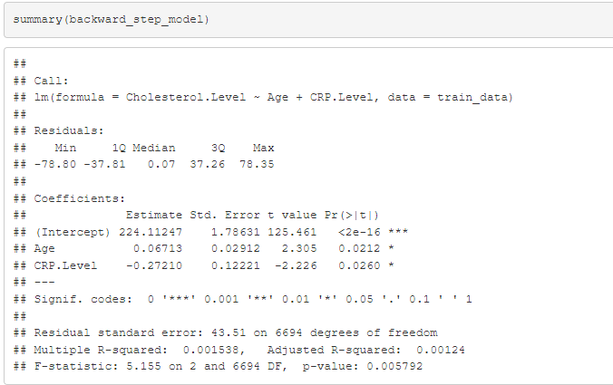
Linear Regression Modeling (Approach)
Subset selection (Backward Step):

Slide 30
Linear Regression Modeling (Summary)
Model Assessment:
Identified ‘Age’ and ‘CRP.Level’ as the only significant predictors
Backward model's statistical significance (p=0.0058)
r2 is very small(0.15%) and explains only 0.15% of cholesterol variation.
Final thoughts after the model assessment process:
This challenges the common assumption about lifestyle factors strongly influencing cholesterol levels
Also, brings a thought that cholesterol is probably influenced by factors like genetics, specific diet etc that are not recorded as part of this dataset.
Linear models might just not be sufficient to make predictions out of this dataset and might need some other complex models.

Slide 31

Model Prediction on Test data
Observations:
RMSE of 43.86 denotes the model prediction are not accurate at all and off by 44 mg'dL when predicting cholesterol levels.
MAE of 38.05 denotes that the predictions differ from actual values by about 38.05 mg/dL
R-squared of -0.003 reveals the model performs worse than using the mean choelsterol value for all predictions.
Conclusion: The variables (Age and CRP Level) are not good for predicting cholesterol values. The model can't practically predict cholesterol from the variables in the dataset; meaning the cholesterol levels may vary due to other factors not in this dataset; the relationships between the variables and cholesterol might not be a linear one and might be complex than initially thought it would be.

Slide 32
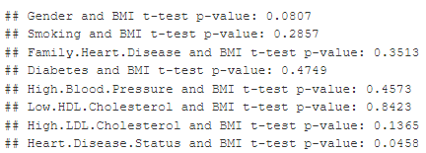
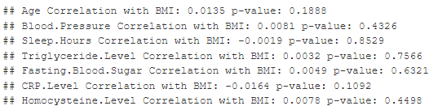

So that’s it? Nope, we try on BMI as our response variable! ☹
T-test
ANOVA
Correlation

Slide 33
Hypothesis Testing (Summary)
Significant categorical variables (p < 0.05): 1. Only Heart Disease Status (t-test) showed a marginally significant relationship with BMI (p = 0.0458) which is less than the expected p<0.05 and Gender (t-test) was close to significance (p = 0.0807).
Significant numerical variables (p < 0.05): No statistically significant variables were found.
Overall finding: ‘All the other categorical and numerical variables showed no significant relationships with BMI’
What next?
Do exact same thing, we did with Cholesterol Level

Slide 34
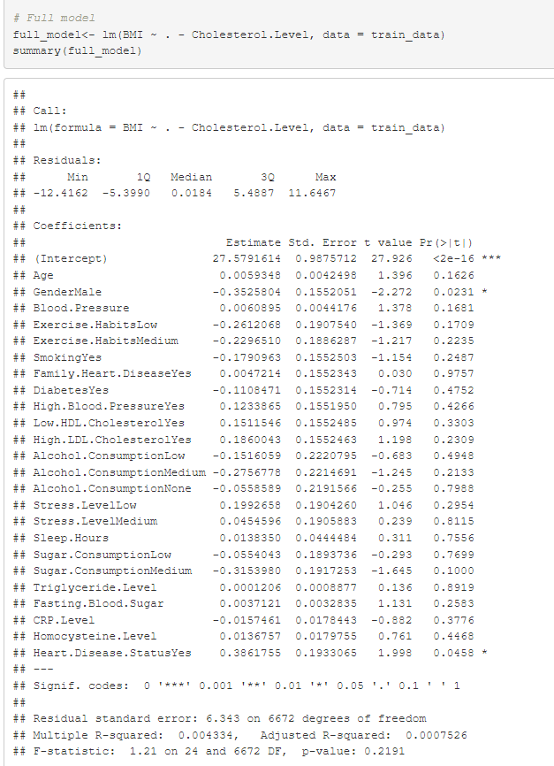
Linear Regression Modeling (Approach)
Subset selection (Full):

Slide 35
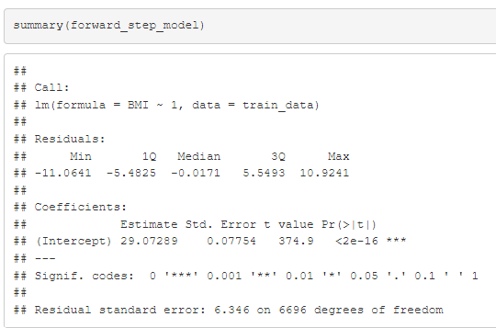
Linear Regression Modeling (Approach)
Subset selection (Forward Step):

Slide 36
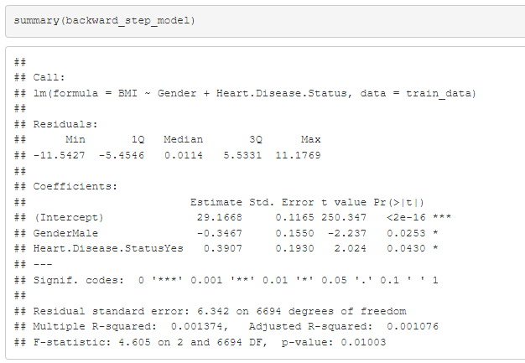
Linear Regression Modeling (Approach)
Subset selection (Backward Step):

Slide 37

Model Prediction on Test data
Observations:
RMSE of 6.17 denotes the model prediction are not accurate at all and off by 6.17 units when predicting BMI.
MAE of 5.29 denotes that the predictions differ from actual values by about 5.29 units
R-squared of -0.0014 reveals the model performs worse than using the mean BMI for all predictions.
Conclusion: The variables (Gender and Heart Disease Status) are not good for predicting BMI. The model can't practically predict BMI from the variables in the dataset; meaning the BMI may vary due to other factors not in this dataset; the relationships between the variables and BMI(health metrics) might not be a linear one and might be complex models than initially thought it would be

Slide 38

We truly stop here! Thanks for your patience..

